Slide 1

Multimedia technology project winter semester 2024
Student: Stratidis Georgios 3140196

Slide 2
Contents
initial project proposal
player
Enemies
objects
Scenes
Game features
Source code – executable
resources – Tools
9. questions

Slide 3
initial project proposal
Star Wars themed 2d game in Godot
The game will be using the free star jedi font for every label and sounds from the original movies, in order to capture the essence of the theme.
The hero will be a ragged figure with a glowing sword (Jedi), who will be fighting figures with full white whole-body armor (Clones) in three different levels.
The first level focuses on the sole purpose of understanding how the game is played, i.e. the available controls.
As for the second level, there will be a beat the clock logic, so that the user gathers collectibles while avoiding or extinguishing clones.
Lastly, the final level will have many clones coming up to the hero, until the hero reaches the final boss and faces it to win the game.
There will be a global clock which will count the completion time for each level and the total time which took to finish the game.

Slide 4
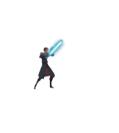
player
Moves with both the keyboard arrows and the w-a-s-d combination
jumps with the spacebar
Performs attack action with the “h” physical key
Defends enemy fire with the “p” physical key

Slide 5

enemies
Chases our player on the x-axis, when he enters the detection area
Shoots laser blast every 1.5 seconds
Captures player (reduces player’s health by entering his detection area)

Slide 6
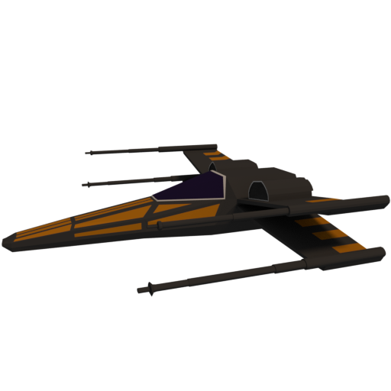


objects
Laser beam: THE product of enemy’s offensive blast
Spacecraft: the getaway vehicle
Collectables: the main objective

Slide 7
Scenes
Main: the central menu of the game
Levels: the levels of the game
Score: the best completion time per level
Guide: the instructions of the game

Slide 8
Game features
Smooth music transition between scenes with a global audio stream player
menu video playback for a background motion effect to imitate the hyper speed
Save and load stats to/from file “savestats.bin”
Global signal for enemy shooting in order to be async
Timer utilities:
Player cannot receive damage immediately (damage cooldown)
Enemies shoot on cooldown (shot cooldown)
Beam disappears after 1.5 second of being fired
Level 2 countdown

Slide 9
resources - tools
menu ui concept and elements: Personal Figma Project
Music: Copyright free music
dynamic background video: Free editor
images: Star Wars Fandom
Game kit: ansimuz / spritedatabase

Slide 10
Source code - executable
The source code for the game can be found here: github repo - onedrive
Run the project by opening the godot project file, while having already the godot engine installed
Run the executable created by the export process of the engine using an openssl self-signed certificate. (script can be provided if requested)

Slide 11
questions?

